Slide 1
COVENANT OF MAYORS CAMPAIGN
Join the movement of European cities detoxifying their heat, opting for a secure and healthy future for all.

Slide 2
WHY
?
To improve air quality and health in cities, especially dense urban areas, protecting your city’s environment and citizens’ wellbeing.
To support a more energy-efficient, modern, and circular economy, creating jobs in a new industry.
To ensure energy security and a just transition that combats energy poverty and mitigates climate change’s long-term effects on local communities.

Slide 3
WHAT can cities do to
To heat cities, there’s no need to burn toxic sources. Cities can detox heat on a large scale by massively shifting towards cleaner, more modern, and sustainable heating systems. Detox your heat in 3 steps:
their heat?
Step 1. Prepare a heating & cooling plan to identify heat sources, demand and potential alternatives.
Step 2. For a more impactful detox that reduces heating-related toxins on a large scale, expand, renovate or develop district heating & cooling where possible.

Slide 4
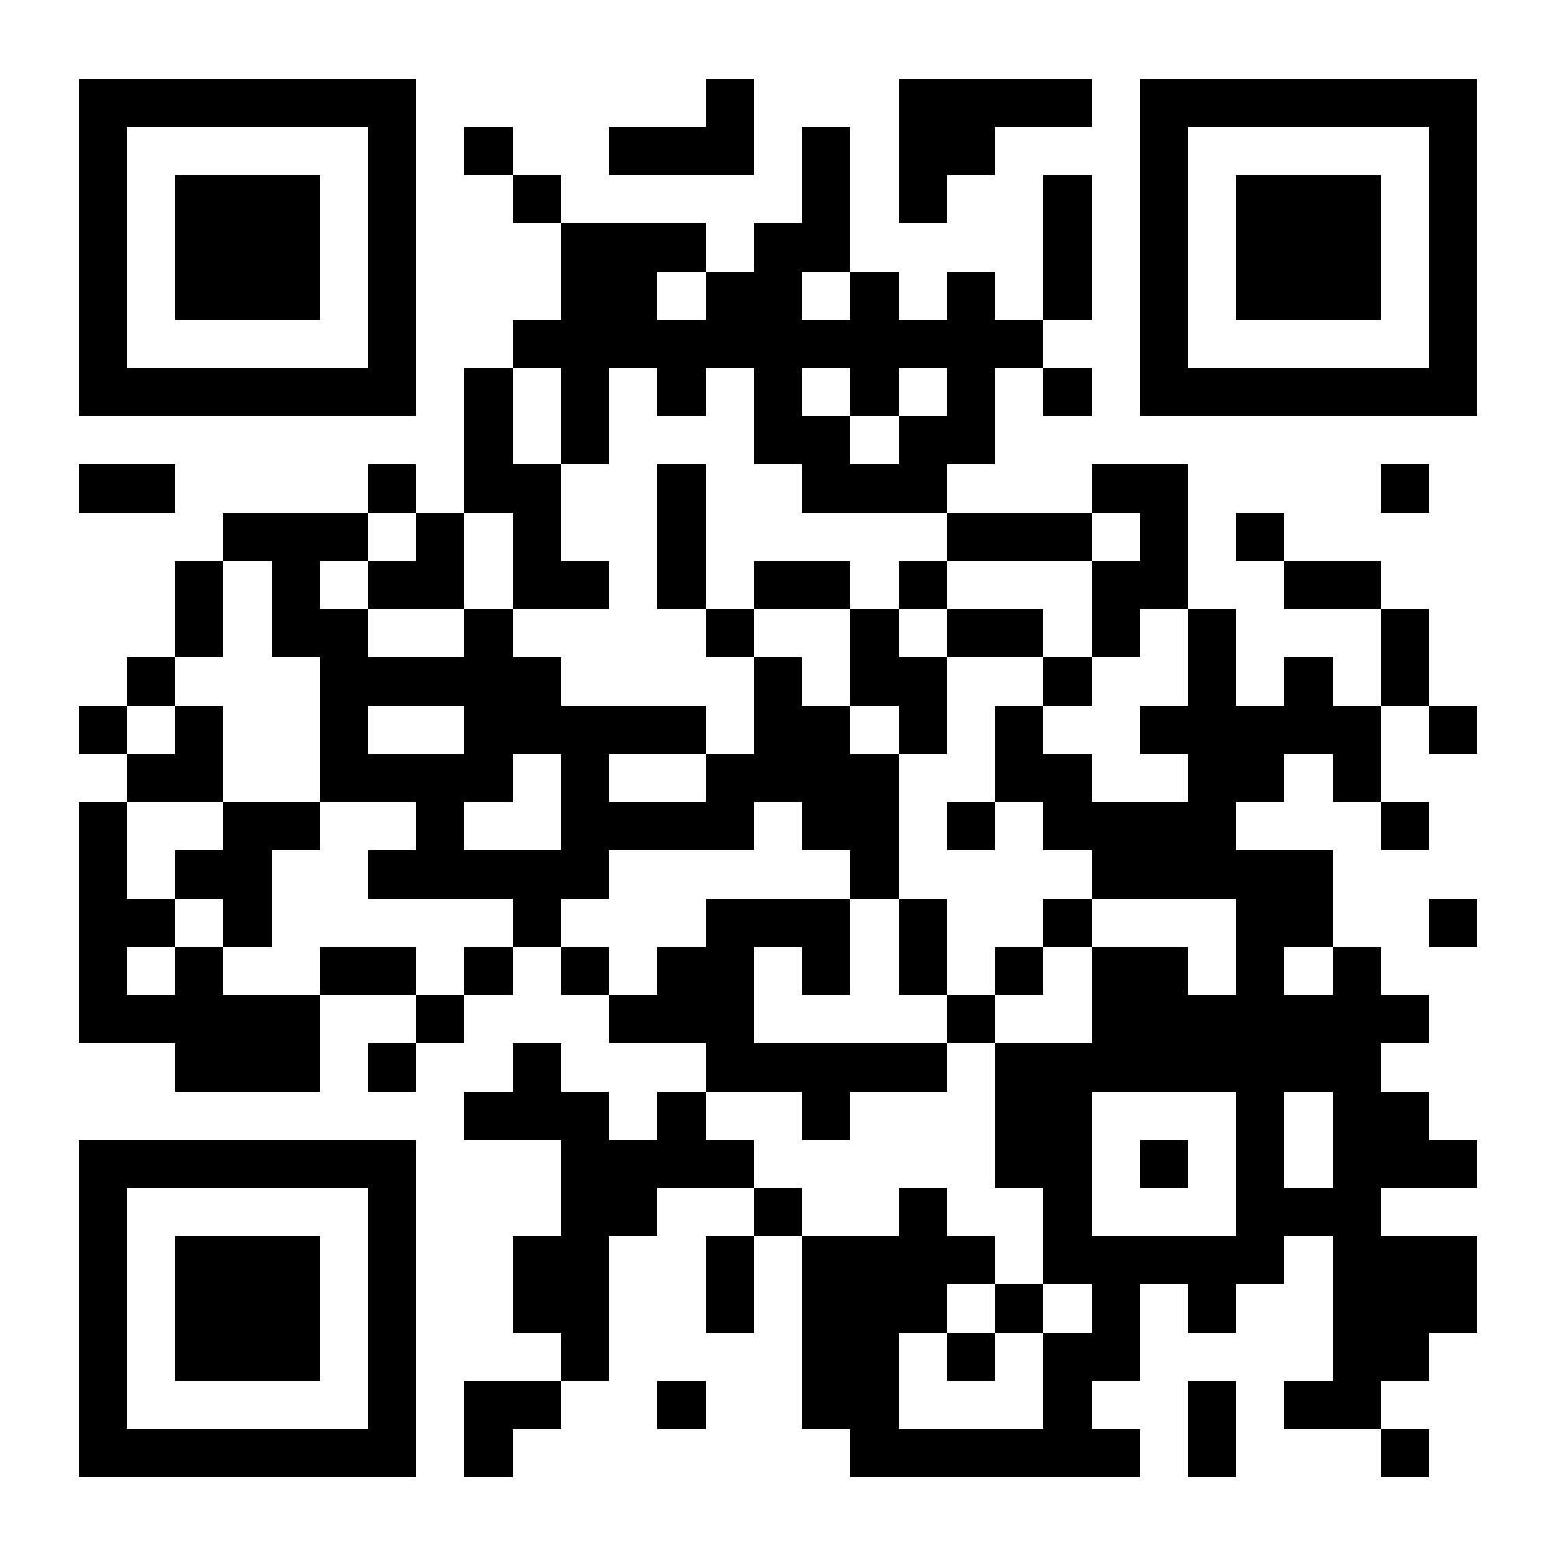
WHAT can cities do to
their heat?
Step 3. Rejuvenate your city’s heating system by feeding your district heating networks with clean, healthy heat sources that are most adapted to your territory, like geothermal, solar, recovery waste heat or with air and water heat pumps.
You’ve already undertaken one of these three steps?
Share your city’s heat detox!
https://eu-mayors.ec.europa.eu/en/Cities-Heat-Detox-Communication-Package-Cities

Slide 5
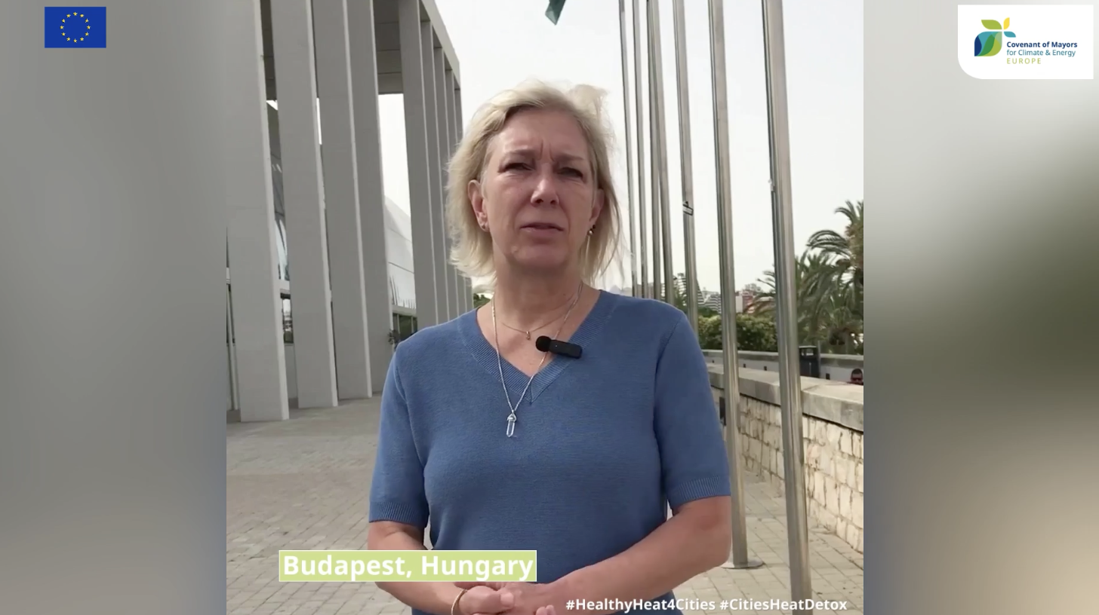
HOW are cities
ing their heat?
You’re working on your city’s heat detox?
Submit your story to get featured on our map!
https://eu-mayors.ec.europa.eu/en/Cities-Heat-Detox-Communication-Package-Cities
DETOX MAP
Find inspiration in our map of best practices and stories of detoxes displayed on an interactive map.

Slide 6
WHAT do cities need for a successful heat
?
For a successful #CitiesHeatDetox, cities need to tap into different dimensions of wellbeing, for a holistic and effective detox.
1) Access to data
Access to a database of existing building stock for municipalities’ heat planning and zoning
2) Municipal Resources
Local capacity and staff and long-term financial support to carry out heat planning, training new professionals and developing new infrastructures, energy advice to citizens, law enforcement, etc.
3) Favourable Legal Frameworks
Legal possibilities to enforce energy zoning and heat planning, like an obligation to connect to district heating
Restriction or bans on fossil fuel boilers, supportive legislation to reduce gas demand
Removal of obligations to connect buildings to gas networks

Slide 7
WHAT do cities need for a successful heat
?
For a successful #CitiesHeatDetox, cities need to tap into different dimensions of wellbeing, for a holistic and effective detox.
What does your city need to successfully detox their heat?
4) Technology clarity
Clarity about heating systems, timelines and differentiation in subsidies, to establish investment security for business owners, utilities, etc.
5) Incentives and subsidies
Economic incentives: prices, taxes and subsidies to cushion investment costs
Incentives and financial support for exploitation of local heat potential
Encouraging heating system exchange in combination with renovation
6) Cooperative Local Ecosystem
Incentives and clear benefits for citizens to connect to district heating where available and participate in the heat transition
Leveraging Energy Service companies, from developing advisory desks to engaging with energy city-owned companies
Share your story!

Slide 8
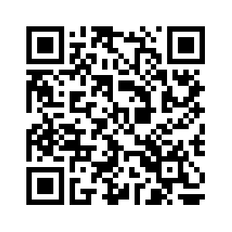
JOIN THE CAMPAIGN
Let's make it loud and clear: Healthy heat in cities means a healthy future for Europe!
SUBSCRIBE
TO THE CAMPAIGN
Receive our regular updates, resources and opportunities to help you in your detox!
SHARE
YOUR CITY’S DETOX MIX
Showcase your city’s own detox with the help of our Heat Detox Comms Package.
CONTRIBUTE
TO THE CAMPAIGN
Visit the website
https://eu-mayors.ec.europa.eu/en/The-Cities-Heat-Detox
Get featured on our Heat Detox Map by submitting your story and/or applying to the Covenant award.
Follow us on Social Media
Contact us
campaigns@eumayors.eu

